Slide 1

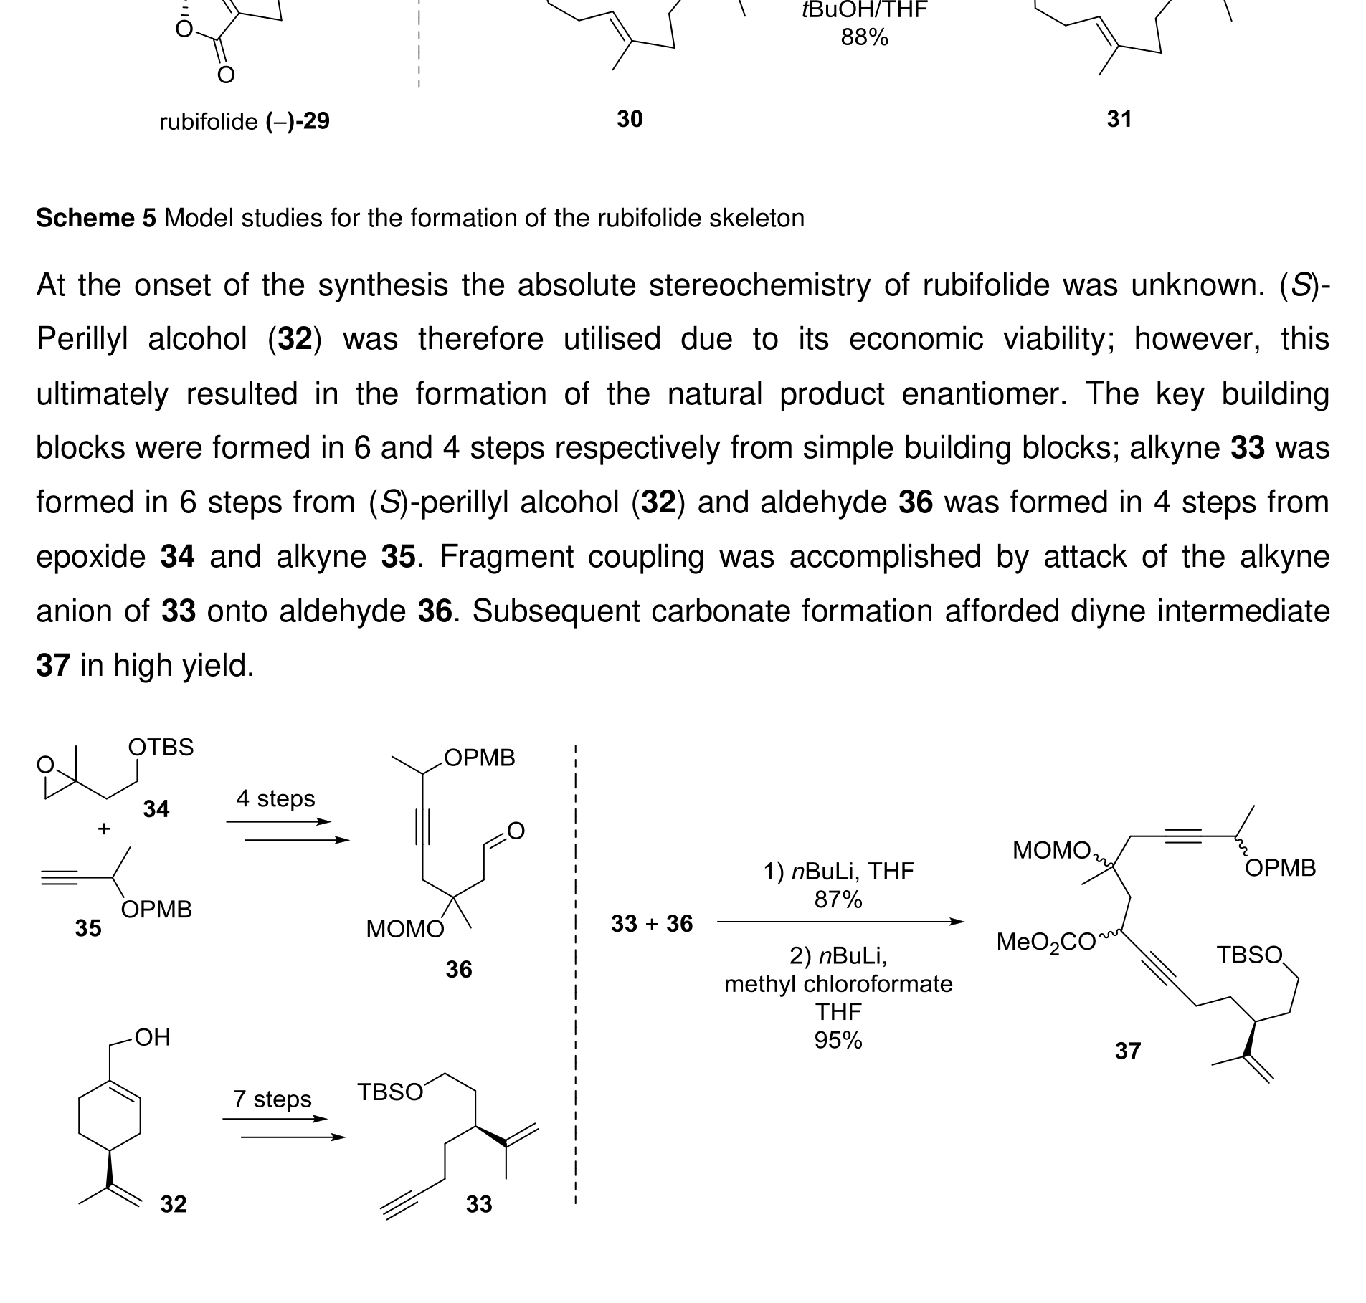

Proof: Scheme refinement (Before → After)
What the service changes on complex chemistry diagrams
Visual-first edits
Clean framing • legibility at 16:9 • consistent layout Premium option: ChemDraw redraw + style-sheet standardization
BEFORE (raw thesis layout)
AFTER (cropped, contrast-balanced, readable at 16:9)
Source visuals: University of Glasgow PhD thesis (McAulay, 2017) — used to demonstrate RE4U Visual-First formatting.
1

Slide 2
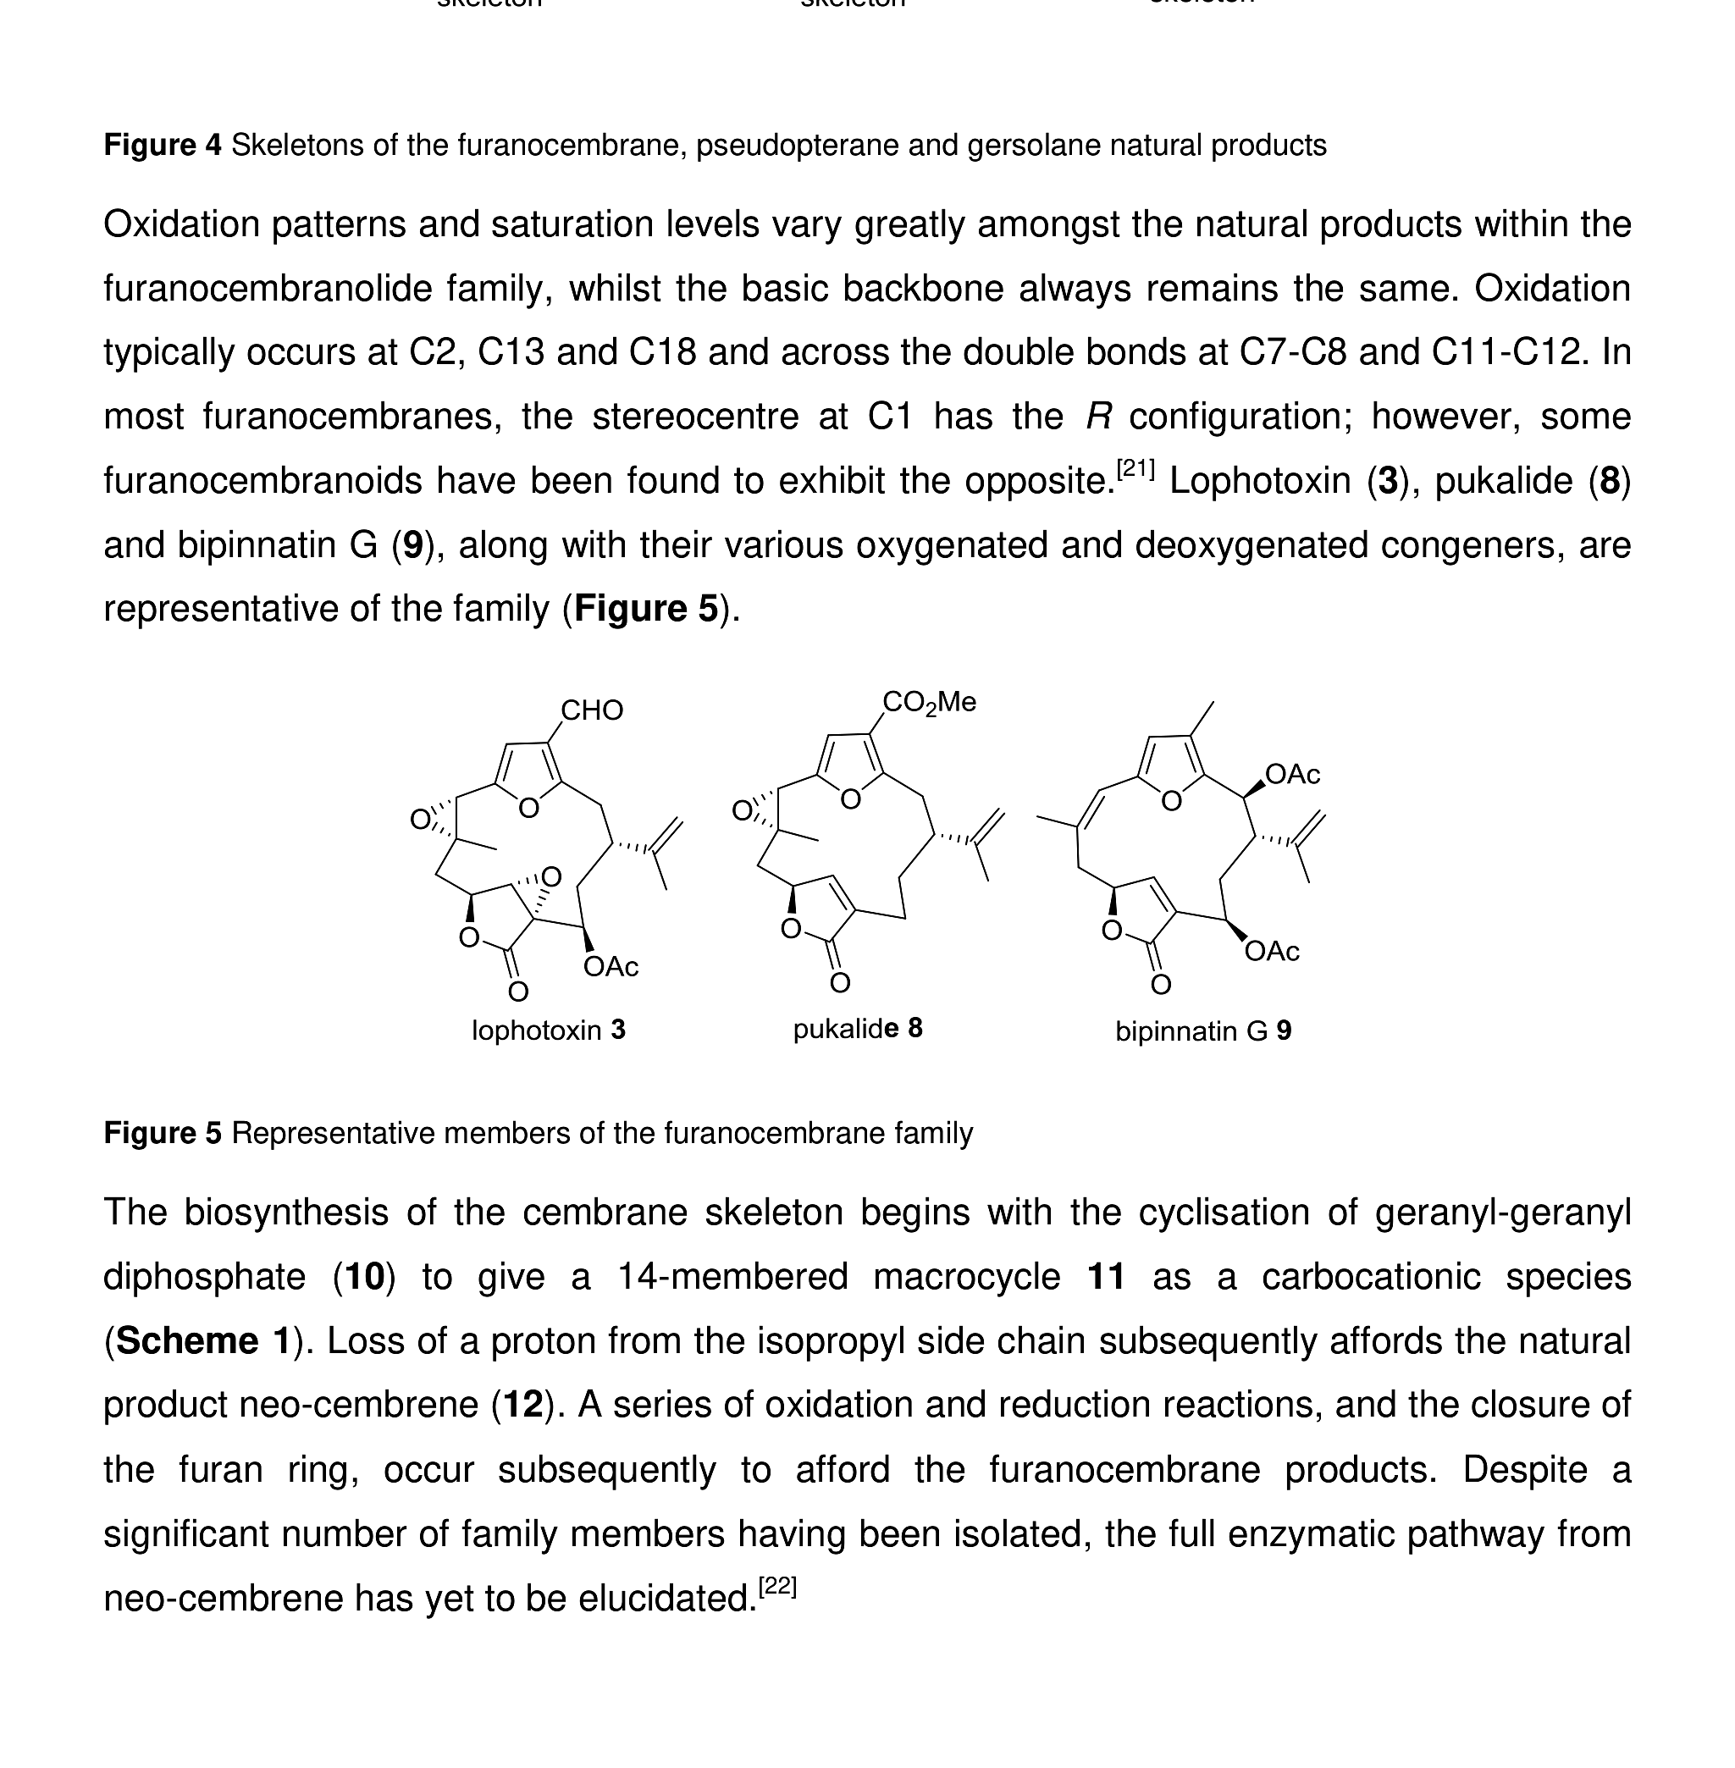
Target & context
Start with the molecule family and the objective
One hero figure + one takeaway line. No dense text.
Source visuals: University of Glasgow PhD thesis (McAulay, 2017) — used to demonstrate RE4U Visual-First formatting.
2

Slide 3
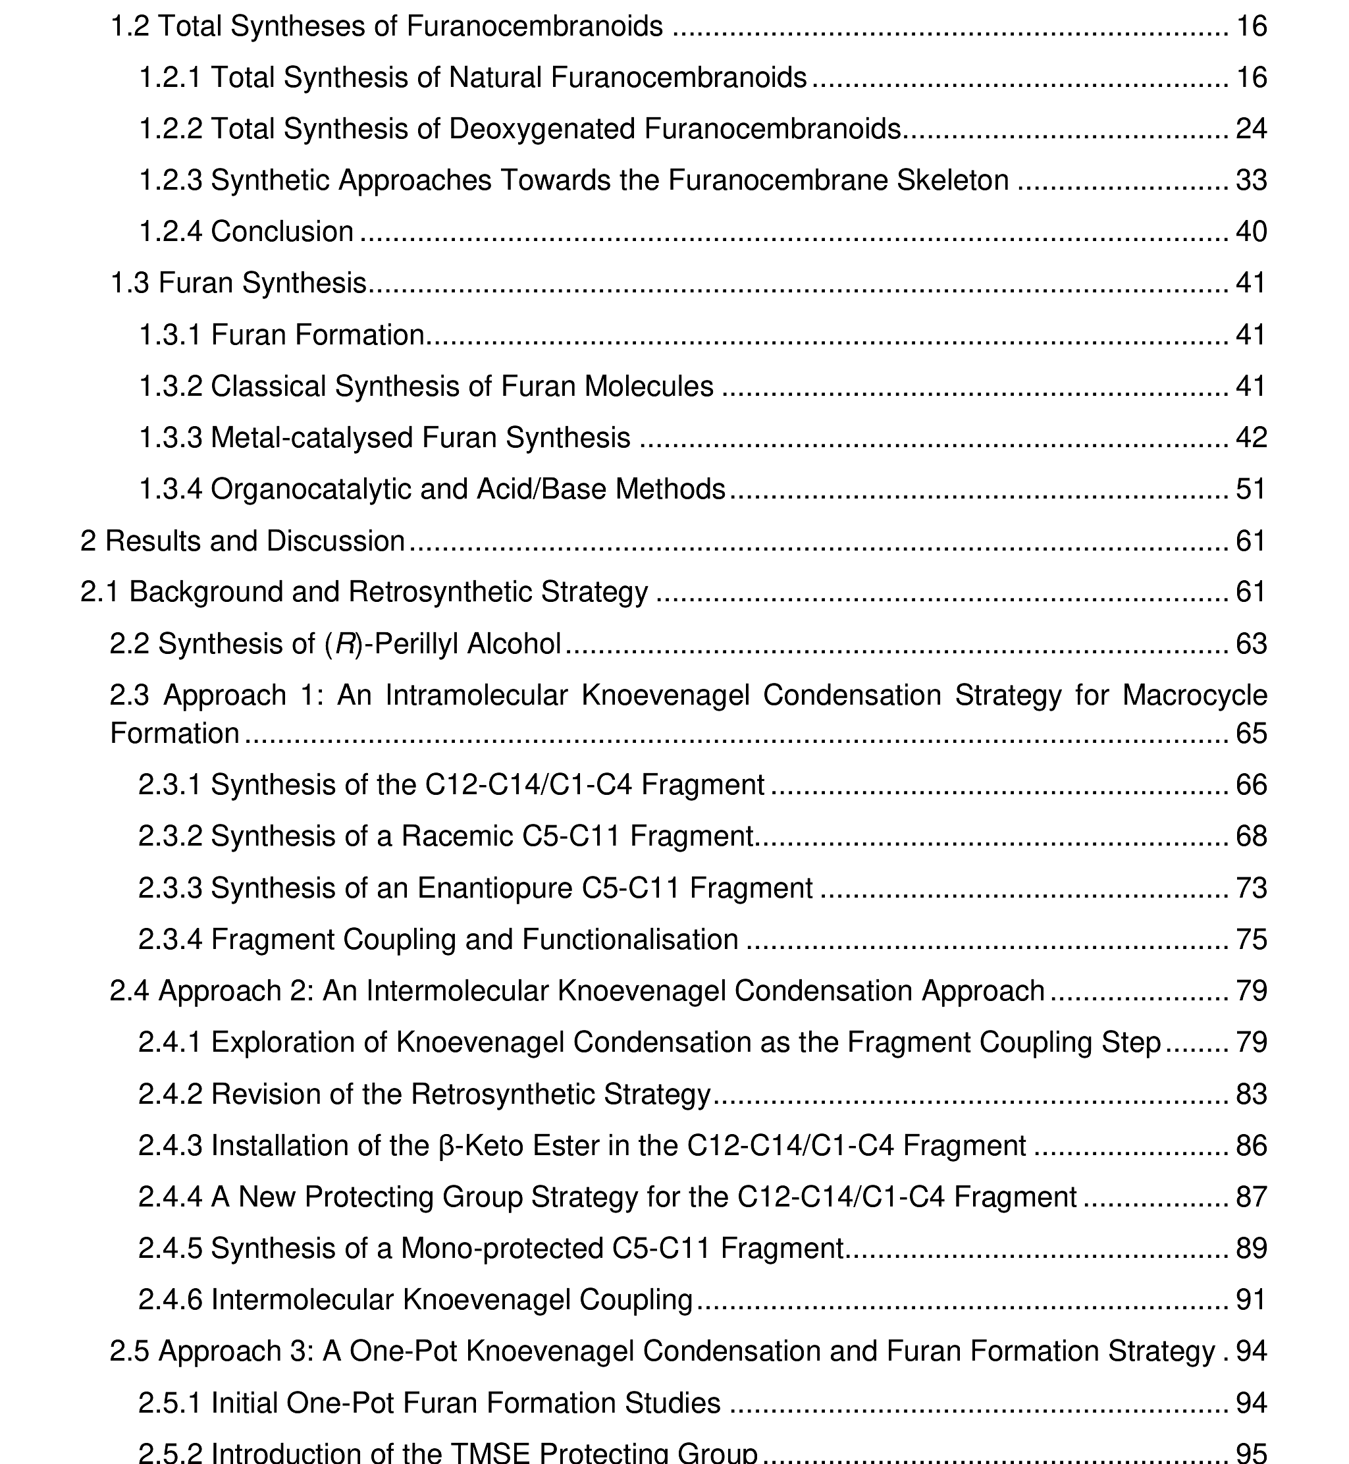
Retrosynthesis overview
Disconnections and convergence points, made readable
Retrosynthesis as a map: disconnections, fragments, convergence.
Source visuals: University of Glasgow PhD thesis (McAulay, 2017) — used to demonstrate RE4U Visual-First formatting.
3

Slide 4
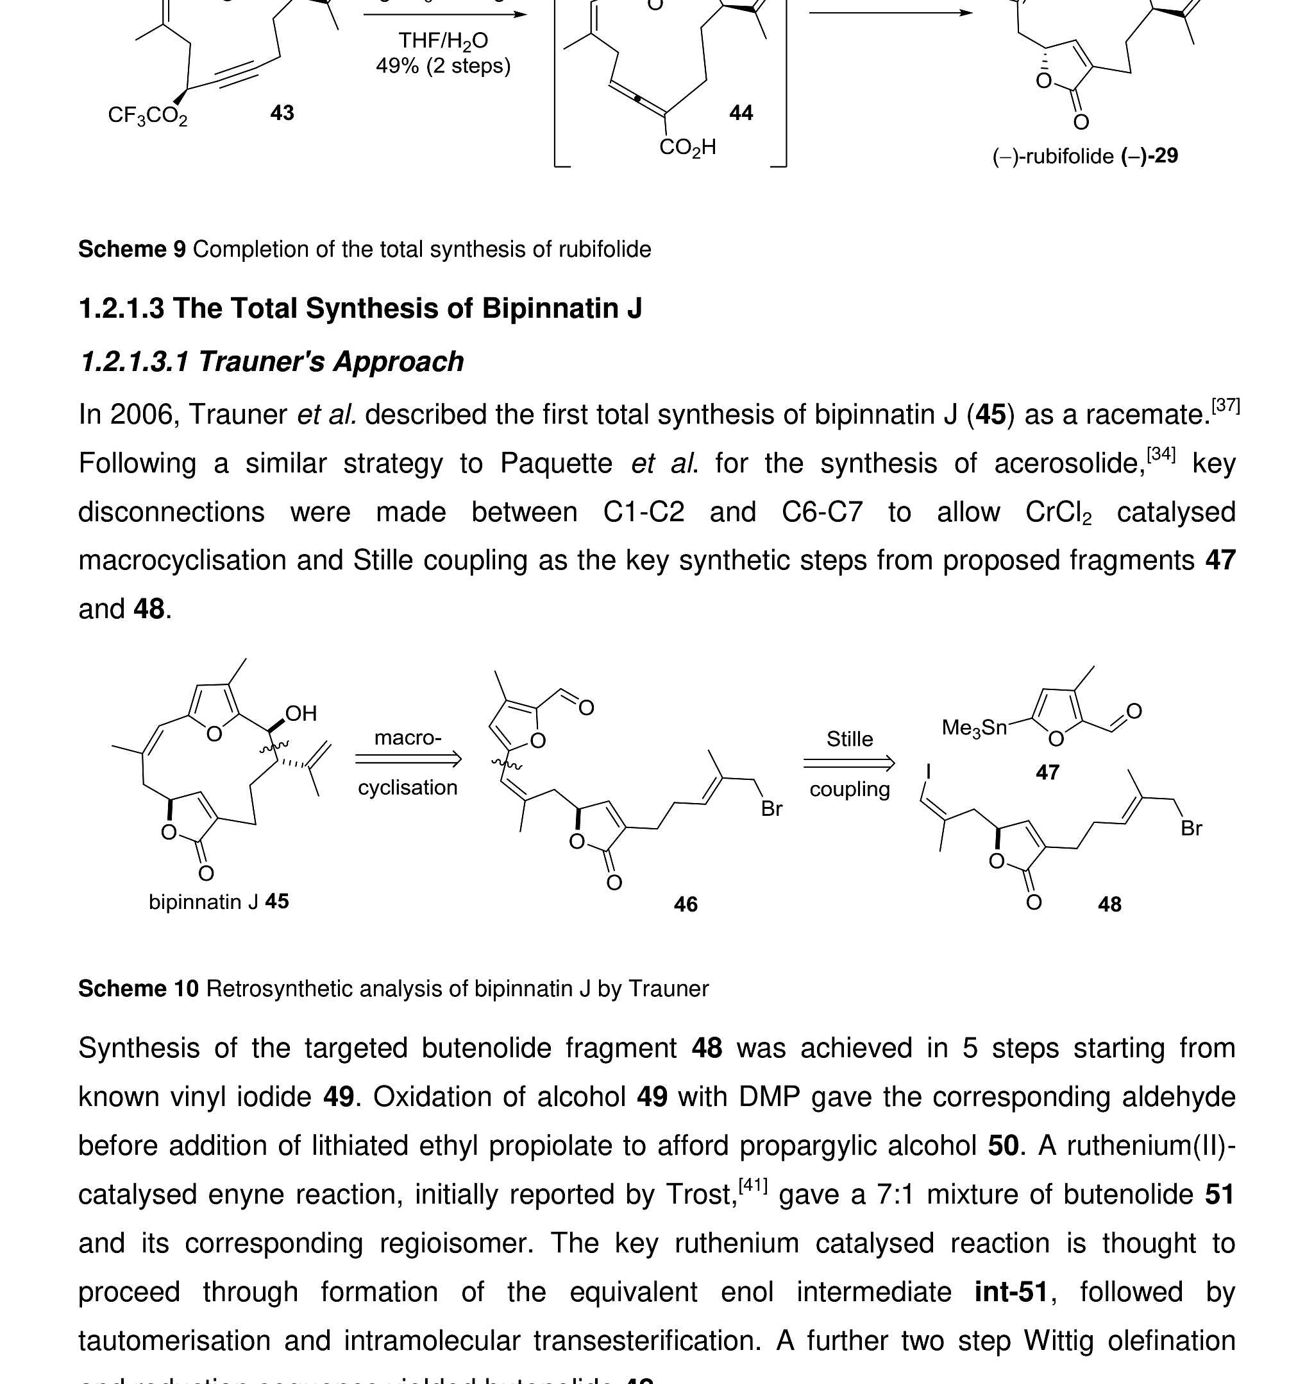
Route map (macro)
Compress long routes into modules before zooming in
Macro route → modules → zoom slides (progressive reveal).
Source visuals: University of Glasgow PhD thesis (McAulay, 2017) — used to demonstrate RE4U Visual-First formatting.
4

Slide 5
Key transformation
One scheme per slide + minimal annotation
One focal scheme per slide. Keep conditions legible.
Source visuals: University of Glasgow PhD thesis (McAulay, 2017) — used to demonstrate RE4U Visual-First formatting.
5

Slide 6
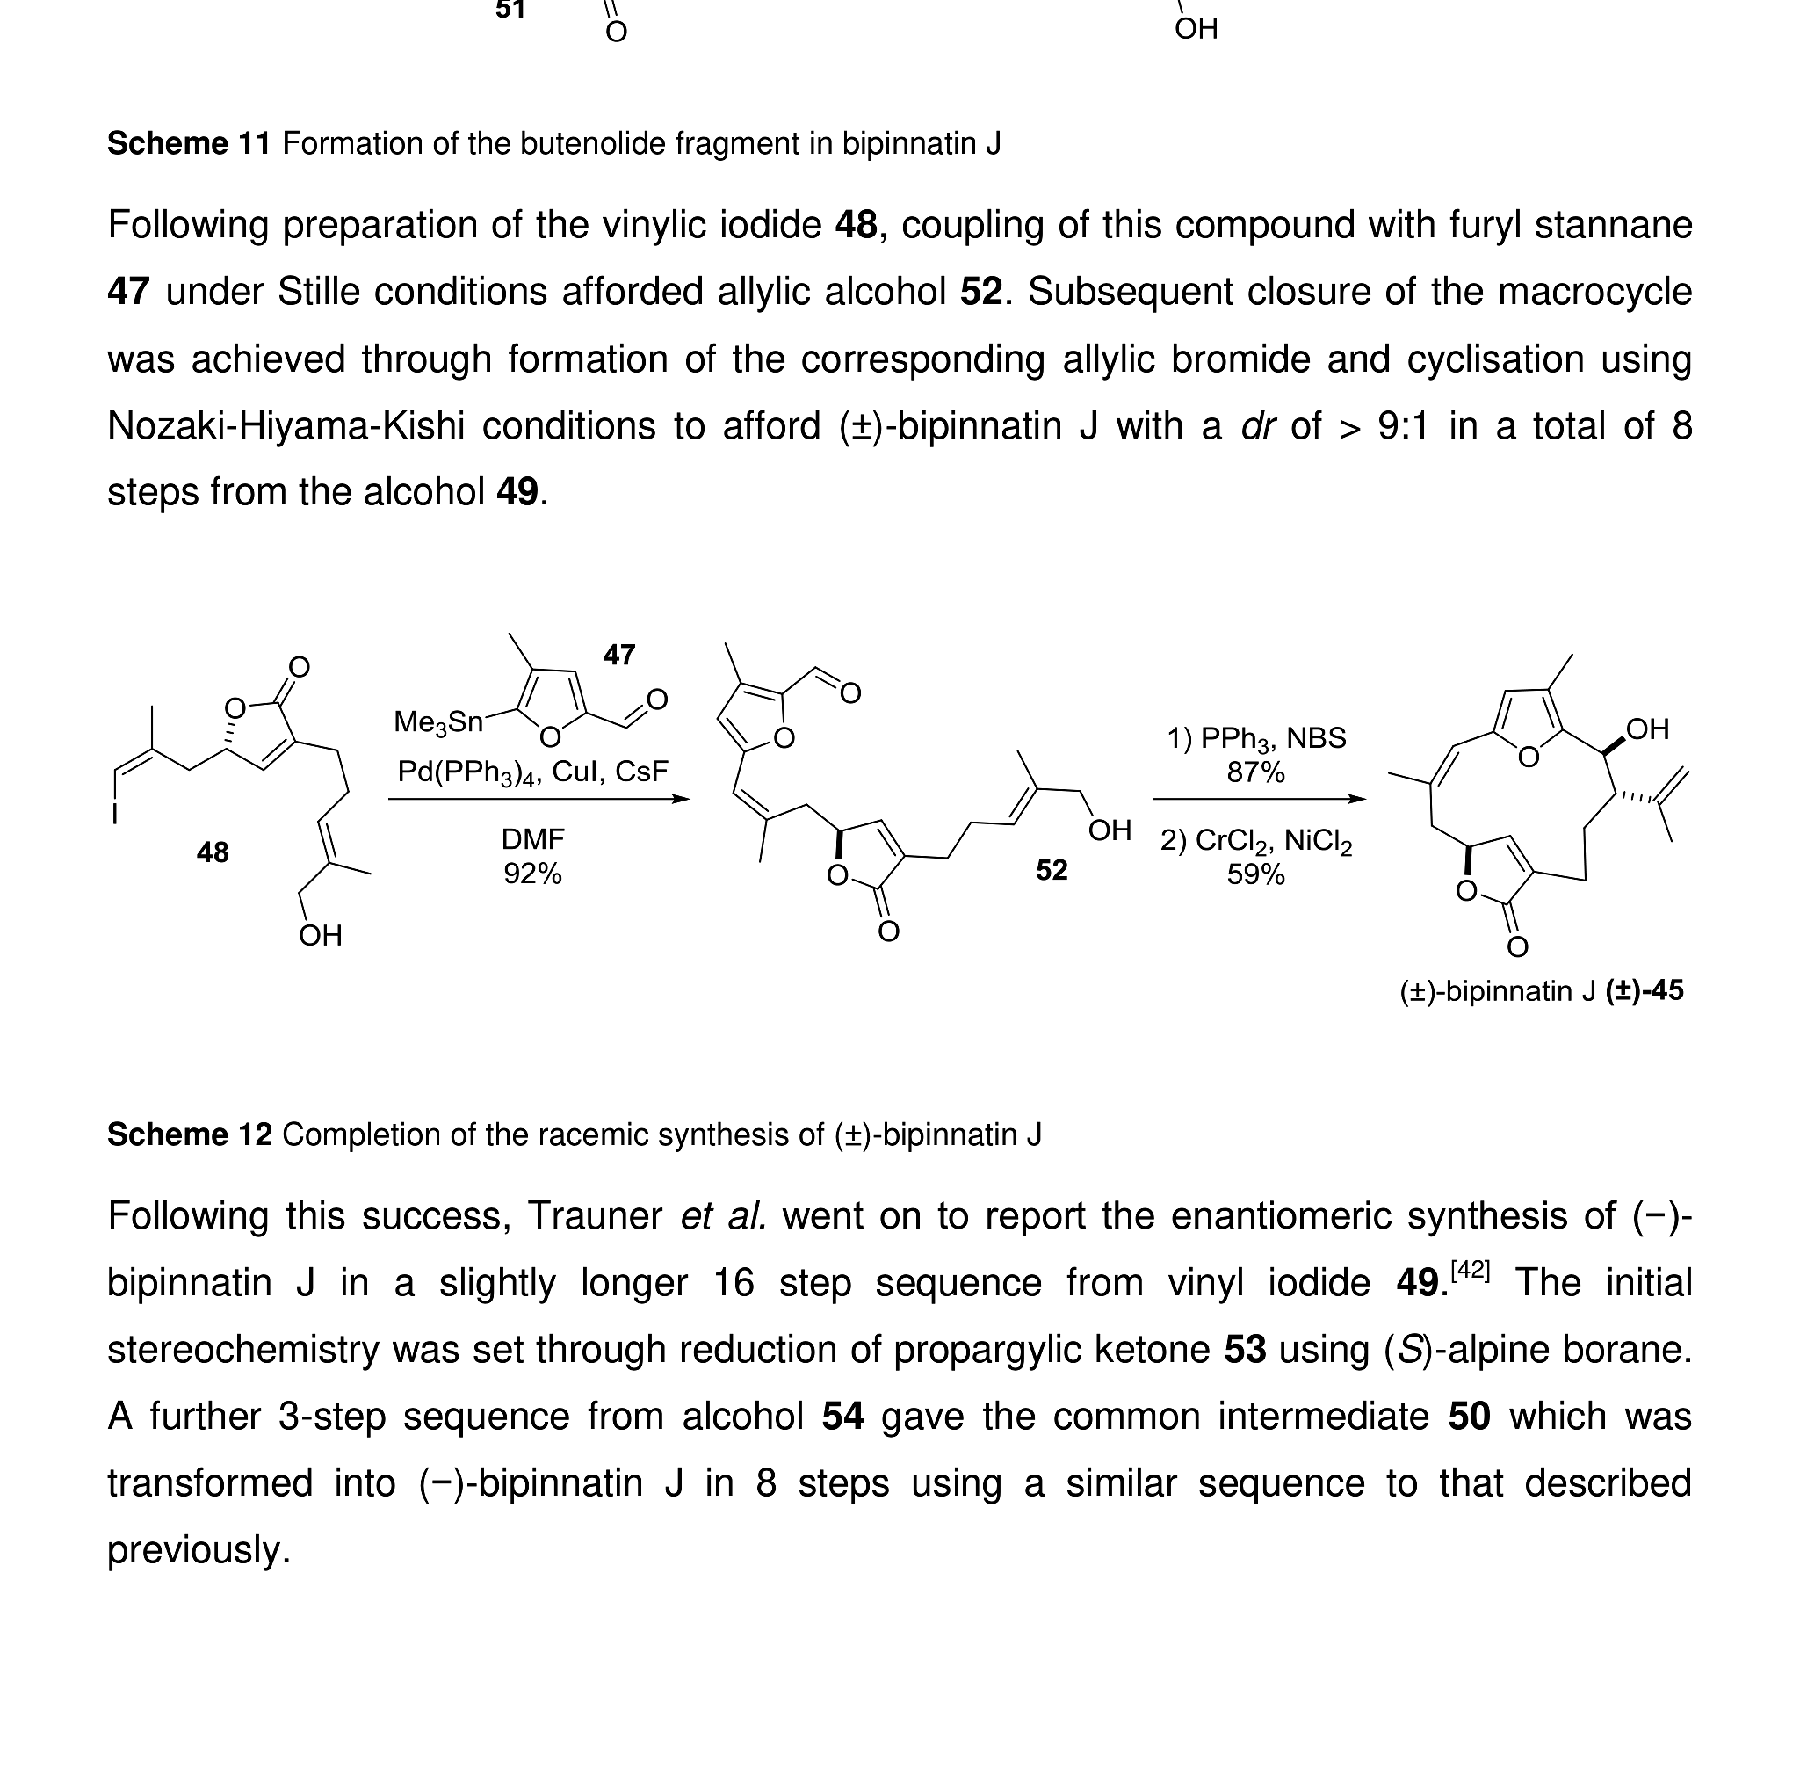
Evidence / precedent
Keep precedent figures consistent in the same visual system
Consistency across figures prevents cognitive overload.
Source visuals: University of Glasgow PhD thesis (McAulay, 2017) — used to demonstrate RE4U Visual-First formatting.
6

Slide 7
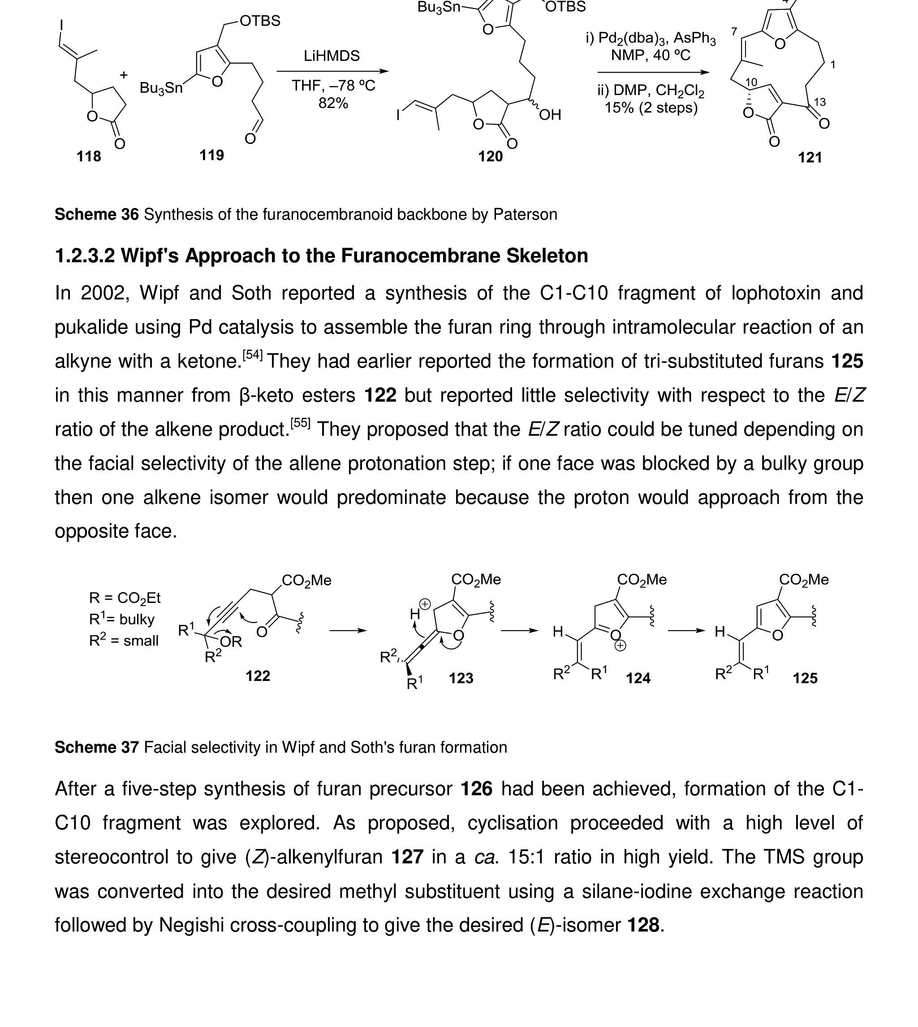
Data slide (table)
Tables must be rebuilt for slide readability
RE4U table redesign
Rebuild as editable table • readable font sizes • highlight best entry Stable columns • clear units • single takeaway
Visual First includes data: tables/plots redesigned for committee readability.
Source visuals: University of Glasgow PhD thesis (McAulay, 2017) — used to demonstrate RE4U Visual-First formatting.
7

